Slide 1
Then and Now
1956 Melbourne Olympics compared to today

Slide 2
1956 Olympics
Now
PROV, VPRS 10742/P0, Unit 8, A630
Finish 200 meters 9th heat 1st round 1st B. Morrow (55) USA
Sprint finish
Track running
Tracks were made from cinders but have improved to the current Mondo tracks which are made of thin rubber that can be rolled out like carpet.
Speed suits are worn to reduce wind resistance and to compress the athlete's muscles allowing blood to flow through them faster and also reducing vibrations.

Slide 3
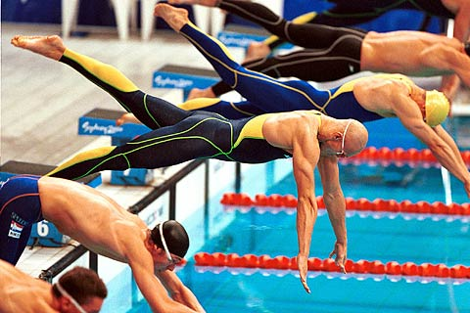
1956 Olympics
Now
PROV, VPRS 10742/P0, Unit 13, B1517
Swimming - John Hendricks (Australia) puts on his track suit after the race.
Michael Klim starting in the freestyle
Swimming
The latest swimsuits have been designed to maximize the flow of water over the body, reducing the effects of drag.
Goggles are worn to protect the eyes of the swimmer.
Swimming caps are designed to reduce the effect of water resistance over the head.

Slide 4
1956 Olympics
Now
PROV, VPRS 10742/P0, Unit 16, C2026
Ploog finish 1000 Metre Sprint 1/4 finals Heat 2 R. Ploog (Aust) v J. Disney (USA). Ploog wins second heat.
"Cat and Mouse” tactics in the Individual Sprint
Cycling
The frame of the bicycles and the wheels are made from carbon fibre, an extremely strong and light material. This results in weight reduction and superior acceleration compared to the standard tube framed bicycles .
Helmets are designed to be aerodynamic with a pointed ‘tail’ which is designed to reduce helmet drag.

Slide 5
1956 Olympics
Now
PROV, VPRS 10742/P0, Unit 6, A279
High jump 328 V. Sitkine of USSR qualifies 6' 3-1/2"
Foam landing mat
High jump
A soft foam mat is used for landing on compared to sand in the 1956 Olympics
The high jump bars are made from glass-reinforced plastic or aluminium

Slide 6
1956 Olympics
Now
PROV, VPRS 10742/P0, Unit 8, A665
Modern landing pit
Pole vault
The pole is made up of carbon fibre and fibre-glass and is designed to be able to bend and take the weight of the athlete.
The landing pit is padded with a thick soft mat to cushion the impact of landing compared to the sand bags in the 1956 Olympics.

Slide 7
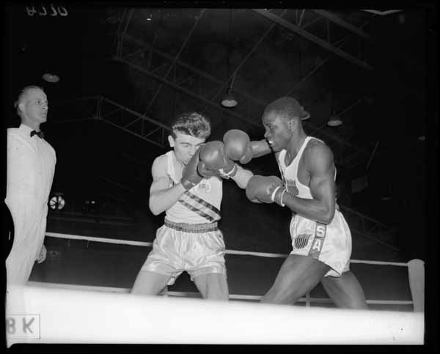
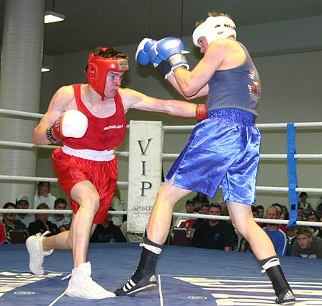
1956 Olympics
Now
PROV, VPRS 10742/P0, Unit 9, A770
Boxing - J. Shaw (76, USA) vs. M. Carlos (79, Australia). Shaw won on points.
Boxing
A cushioned, soft leather helmet is used as a head guard. It is a compulsory part of the clothing and is designed to provide additional protection from head blows.
The gloves have a white area that shows the striking surface.

Slide 8
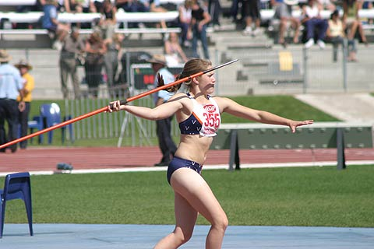
1956 Olympics
Now
PROV, VPRS 10742/P0, Unit 11, B1127
Javelin
Traditionally, javelins were solid wood with a metal head, but now they are made of hollow steel and fibreglass
Javelins were changed by moving the centre of gravity closer to the head. This caused the head to dip down faster and made the sport safer with fewer flat landings.

Slide 9
1956 Olympics
Now
PROV, VPRS 10742/P0, Unit 15, B1927
Gymnastics Elena Lagorara Italy horse vaulting
Gymnastics – Vault
The Pegases vault table has a full wide push-off area, protective padding, easy-to-operate height adjustment and is suitable for men and women.
Vault using the Pegases vault table
The vault runway is made of carpet and foam layers and is used to reduce stress
injuries to the legs and feet.
Landing mats are made of foam and polyethylene and are designed to absorb impact
and force.

Slide 10
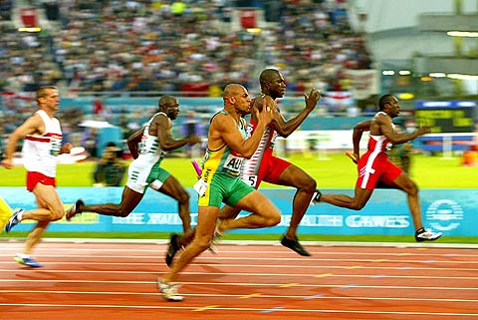
1956 Olympics
Now
PROV, VPRS 10742/P0, Unit 9, A853
Electronic timing and photo finishes
Officiating
Manual stopwatches have been replaced by high-speed digital cameras, infrared beams and radio transmitters to record times. At a finish line, digital cameras can scan an image up to 2,000 times a second.

Slide 11
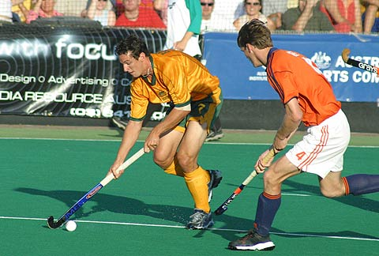
1956 Olympics
Now
The Kookaburras
playing the Dutch
National Team
PROV, VPRS 10742/P0, Unit 9, A820
Goalkeeper with padding only on legs
Hockey
Surface known as Sand Filled Artificial Grass (SFAG) has revolutionised the game of hockey due to its speed and more reliable bounce in comparison to grass.
Shin guards are worn by all players for protection purposes. They are constructed using foam materials to make them light, yet strong.
Goalkeeper with protective equipment

Slide 12
Sources:
Starting Blocks – An introduction to the Melbourne 2006 Commonwealth Games
Public Record Office Victoria (PROV)

